Slide 1


SUSPICIOUS MILITARY ACTIVITY DETECTION AND ALERT SYSTEM USING RASPBERRY PI
PRESENTED BY
K.P. Dhivyesh Anand (211419205042)
S. Mukundhan (211419205113)
GUIDED BY
K. Lalitha
Asst. Professor

Slide 2
Objective & Scope
To identify possible threats and other anomalies in the defense line
Sharing the information like geo location of the trespassing area and sending of alert notifications to the respective area commandos

Slide 3
Abstract
By recognising and analysing digital images and videos, computer vision is a crucial branch of computer science that helps make machines clever and intelligent.
Suspicious activity recognition, which automatically categorises the actions being carried out by an agent, is an important use of this.
Suspicious activity recognition seeks to identify a enemy commandos actions utilising a series of observations while taking into account different difficult contextual circumstances.
Once the surveillance system's motion detection and tracking are activated, the allied commandos and other military users is notified over the internet.

Slide 4
Literature Survey
S.No | Previously Published Paper | Objective | Pros | Cons
1 | J. K. Aggarwal and M. S. Ryoo, “Human activity analysis: A review,” ACM Comput. Surv., vol. 43, no. 3, 2011, doi: 10.1145/1922649.1922653 | Observing and recoding of human activities | Foundation of data image processing | Old means in current world
2 | A. G. D’Sa and B. G. Prasad, “A survey on vision based activity recognition, its applications and challenges,” 2019 2nd Int. Conf. Adv. Comput. Commun. Paradig. ICACCP 2019, pp. 1–8, 2019, doi: 10.1109/ICACCP.2019.8882896 | Surveys on various dataset image processings | Has a collection of dataset processing tools | No new research, just a survey paper

Slide 5
Literature Survey
S.No | Previously Published Paper | Objective | Pros | Cons
3 | G. Cheng, Y. Wan, A. N. Saudagar, K. Namuduri, and B. P. Buckles, “Advances in Human Action Recognition: A Survey,” no. February, 2015, [Online]. | Learning of Human action detection using open cv | Recognition of Human Action | Limited Image action data processes
4 | C. Dhiman and D. K. Vishwakarma, “A review of state-ofthe-art techniques for abnormal human activity recognition,” Eng. Appl. Artif. Intell., vol. 77, no. August 2018, pp. 21–45, 2019, doi: 10.1016/j.engappai.2018.08.014. | Advanced activity recognition using open cv | More detailed action can be derived | Action identification is limited

Slide 6
Literature Survey
S.No | Previously Published Paper | Objective | Pros | Cons
5 | S. A. R. Abu-Bakar, “Advances in human action recognition: An updated survey,” IET Image Process., vol. 13, no. 13, pp. 2381–2394, 2019, doi: 10.1049/ietipr.2019.0350 | Surveys on various dataset image processing | Has a collection of dataset processing tools | No new research, just a survey paper
6 | T. Huynh-The, B. V. Le, S. Lee, and Y. Yoon, “Interactive activity recognition using pose-based spatio–temporal relation features and four-level Pachinko Allocation Model,” Inf. Sci. (Ny)., vol. 369, pp. 317–333, 2016, doi: 10.1016/j.ins.2016.06.016. | Advanced activity recognition using open cv | More detailed action can be derived | Action identification is limited

Slide 7
Literature Survey
S.No | Previously Published Paper | Objective | Pros | Cons
7 | S. Abdelhedi, A. Wali, and A. M. Alimi, “Fuzzy logic based human activity recognition in video surveillance applications,” Adv. Intell. Syst. Comput., vol. 427, pp. 227–235, 2016, doi: 10.1007/978-3-319-29504-6_23. | Video data processing achieved using fuzzy logic | Usage of Fuzzy logic in dataset reading | Limited activity recognition
8 | P. Guo, Z. Miao, Y. Shen, W. Xu, and D. Zhang, “Continuous human action recognition in real time,” Multimed. Tools Appl., vol. 68, no. 3, pp. 827–844, 2014, doi: 10.1007/s11042-012-1084-2 | Video data processing achieved using various datasets | Monitoring of continuous human activities | Limited action recognition

Slide 8
Existing System
•Object Detection is the process of finding and recognizing real-world object instances such as car, bike, TV, flowers, and humans out of an images or videos. An object detection technique lets you understand the details of an image or a video as it allows for the recognition, localization, and detection of multiple objects within an image.
•It is usually utilized in applications like image retrieval, security, surveillance, and advanced driver assistance systems (ADAS). Object Detection is done through many ways:
•Feature Based Object Detection
•Viola Jones Object Detection
•SVM Classifications with HOG Features
•Deep Learning Object Detection

Slide 9
Proposed System
Activity Recognition is divided into two categories: sensor-based activity recognition and vision-based activity recognition, depending on the system's components.
1. Sensor-based activity recognition employs a network of sensors to keep an eye on an actor's behaviour and some external factors. In order to extract some crucial information from the data acquired from numerous sensors, it may be processed and aggregated. They are also used to train the model utilising various machine learning, deep learning, and data analytics methods.
2. Using a camera-based system, vision-based activity recognition may identify the activities present in an environment by processing and analysing video. These systems often employ digital image processing to draw out relevant data from video, which is regarded as a series of images.
In this project, we used a vision-based system.

Slide 10
Software & hardware Requirements
Hardware:
•Raspberry pi
•Camera
Software:
●Raspberry pi OS
●Python IDE
●OpenCV library

Slide 11
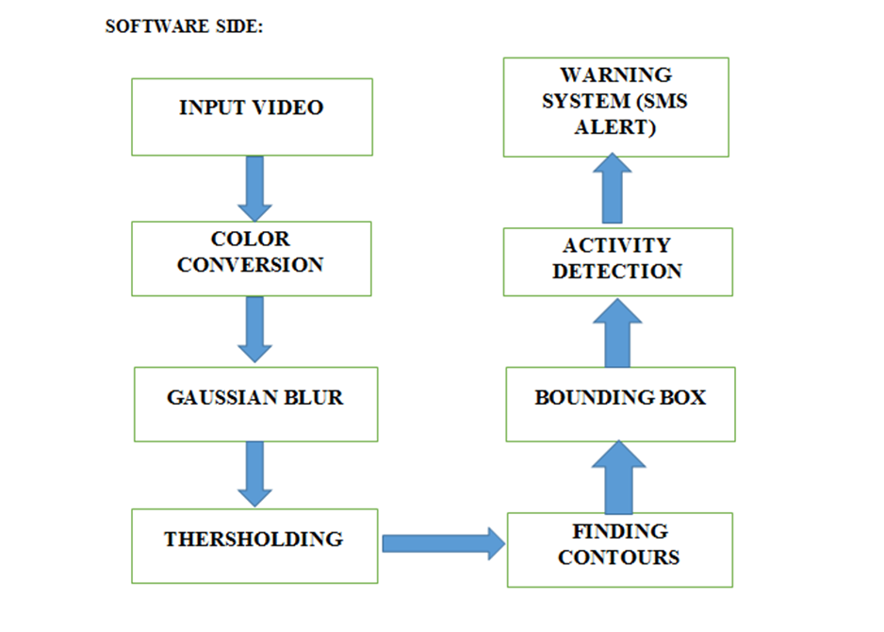
Architecture diagram

Slide 12
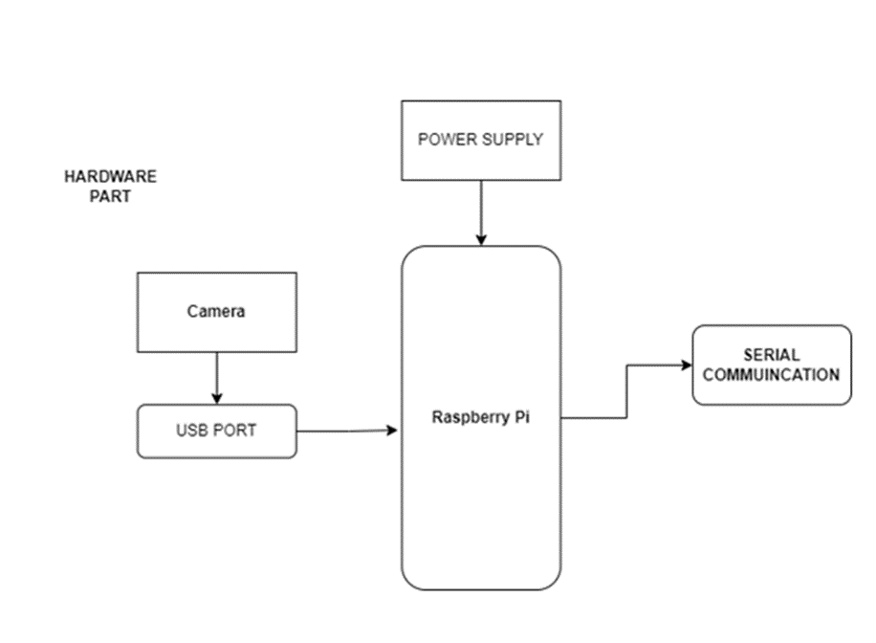

Slide 13
Novelty
The images of the trespasser or objects are sent to the commandos on real time and the live gprs location of the incident
The notification of trespassing is sent to the officials via mial and sms on real time along with the pictures of the trespasser

Slide 14
Module Split Up
Module 1:
Hardware Module
Module 2:
Commandos Module

Slide 15
Module 1:
Hardware Module
Pi board
Dataset Model Training
Testing of Data Set
Detect trespassing
Pass the information to the commandos

Slide 16
Module 2:
Commandos Module
Receive information through mail and sms
See the geolocation and pictures taken
Take the necessary action

Slide 17
References
•[1] J. K. Aggarwal and M. S. Ryoo, “Human activity analysis: A review,” ACM Comput. Surv., vol. 43, no. 3, 2011, doi: 10.1145/1922649.1922653.
•[2] A. G. D’Sa and B. G. Prasad, “A survey on vision based activity recognition, its applications and challenges,” 2019 2nd Int. Conf. Adv. Comput. Commun. Paradig. ICACCP 2019, pp. 1–8, 2019, doi: 10.1109/ICACCP.2019.8882896.
•[3] G. Cheng, Y. Wan, A. N. Saudagar, K. Namuduri, and B. P. Buckles, “Advances in Human Action Recognition: A Survey,” no. February, 2015, [Online]. Available: http://arxiv.org/abs/1501.05964.

Slide 18
•[4] C. Dhiman and D. K. Vishwakarma, “A review of state-ofthe-art techniques for abnormal human activity recognition,” Eng. Appl. Artif. Intell., vol. 77, no. August 2018, pp. 21–45, 2019, doi: 10.1016/j.engappai.2018.08.014.
•[5] S. A. R. Abu-Bakar, “Advances in human action recognition: An updated survey,” IET Image Process., vol. 13, no. 13, pp. 2381–2394, 2019, doi: 10.1049/ietipr.2019.0350.
•[6] T. Huynh-The, B. V. Le, S. Lee, and Y. Yoon, “Interactive activity recognition using pose-based spatio–temporal relation features and four-level Pachinko Allocation Model,” Inf. Sci. (Ny)., vol. 369, pp. 317–333, 2016, doi: 10.1016/j.ins.2016.06.016.

Slide 19
•[7] S. Abdelhedi, A. Wali, and A. M. Alimi, “Fuzzy logic based human activity recognition in video surveillance applications,” Adv. Intell. Syst. Comput., vol. 427, pp. 227–235, 2016, doi: 10.1007/978-3-319-29504-6_23.
•[8] P. Guo, Z. Miao, Y. Shen, W. Xu, and D. Zhang, “Continuous human action recognition in real time,” Multimed. Tools Appl., vol. 68, no. 3, pp. 827–844, 2014, doi: 10.1007/s11042-012-1084-2.
•[9] A. Jalal, M. Uddin, and T. S. Kim, “Depth video-based human activity recognition system using translation and scaling invariant features for life logging at smart home,” IEEE Trans. Consum. Electron., vol. 58, no. 3, pp. 863– 871, 2012, doi: 10.1109/TCE.2012.6311329.
[10] J. Hu and N. V. Boulgouris, “Fast human activity
recognition based on structure and motion,” Pattern Recognit. Lett., vol. 32, no. 14, pp. 1814–1821, 2011, doi: 10.1016/j.patrec.2011.07.013.

